Slide 1
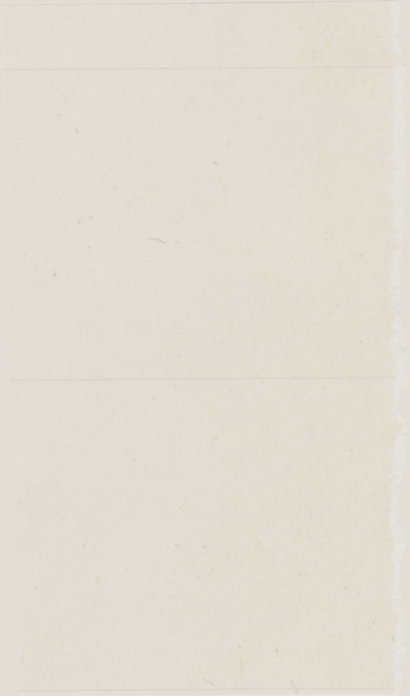


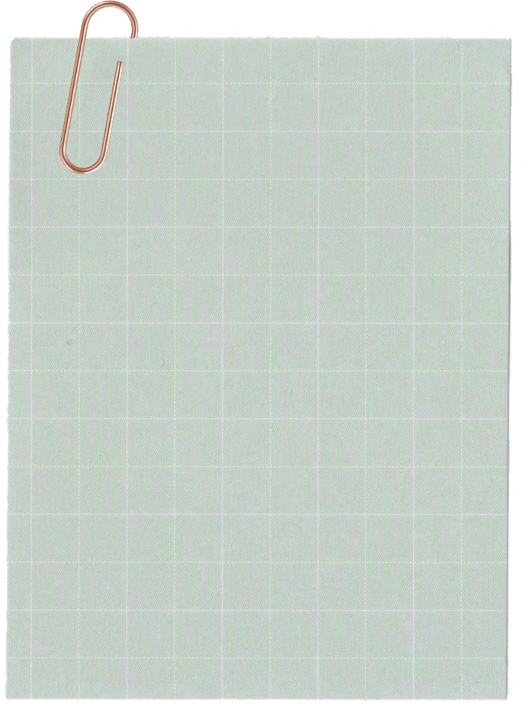
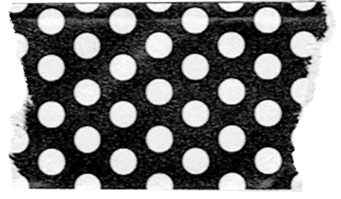
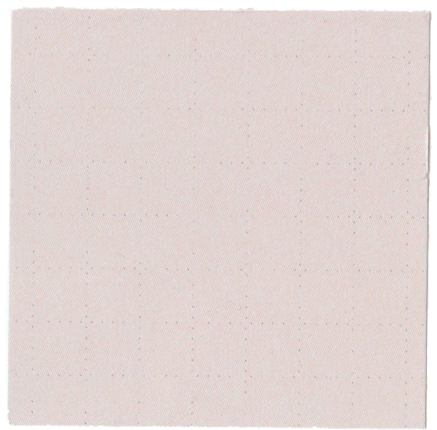

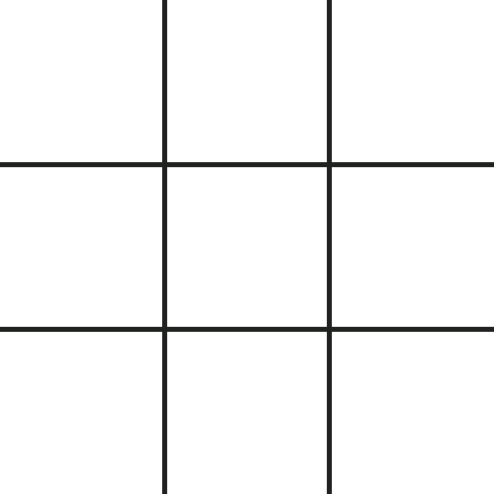



TIC
TAC
TOE

Slide 2
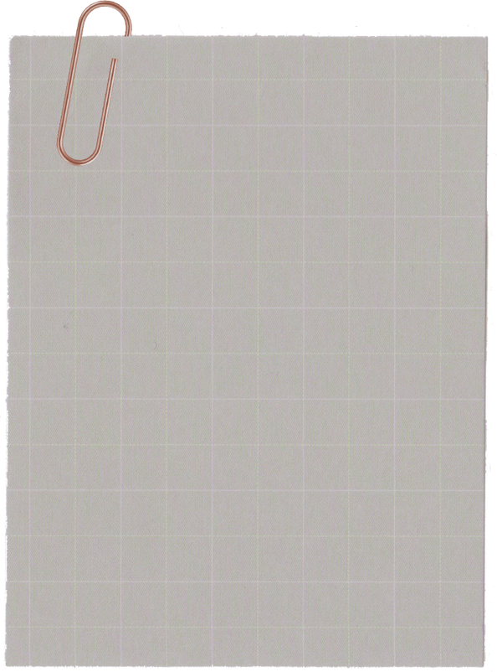
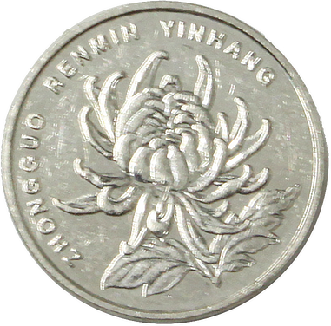
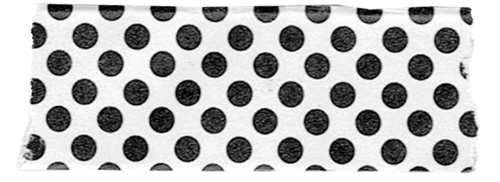
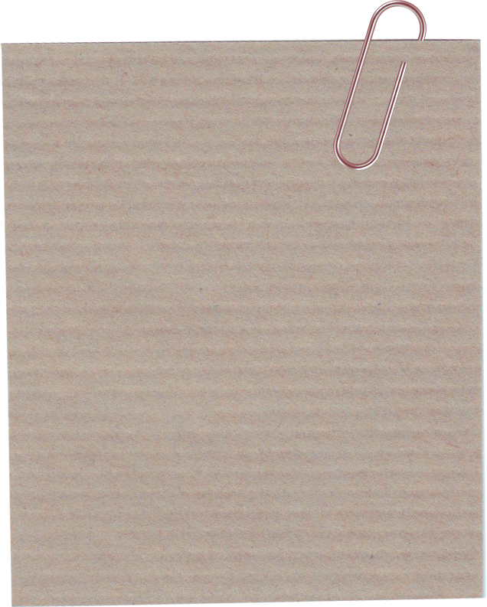

Presenting to:
Group Members:
Sir Adeel Khalid
Ayesha Mehboob
Aneeza Ashraf
Rimsha ulfat
Zainab Khatoon
Topic:
Implementing c concept
17-01-25
to make tic tac toe game

Slide 3
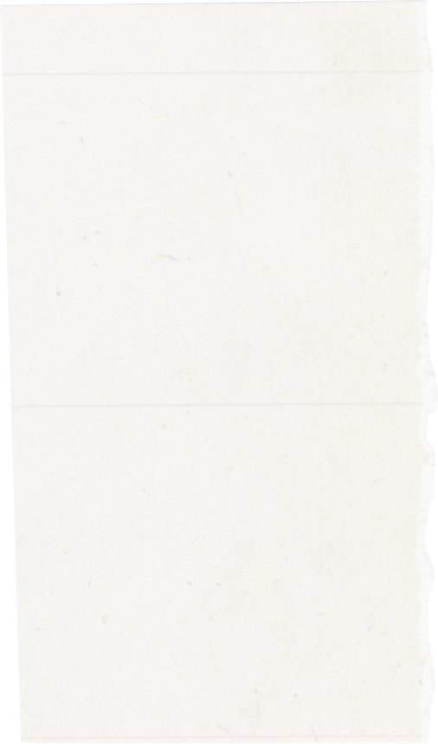

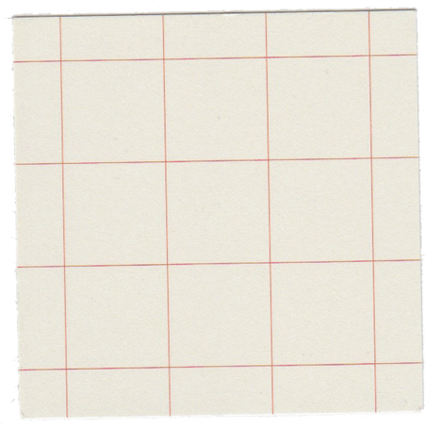
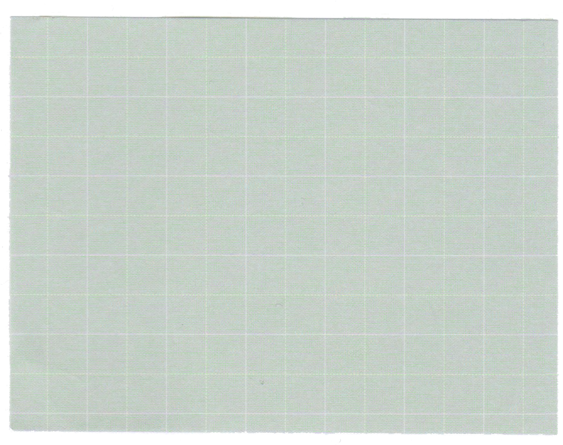
Introduction:
Tic Tac Toe is a simple two-player game played on a 3x3 grid. Players alternate placing their symbols, "X" or "O", with the goal of aligning three symbols in a row, column, or diagonal. The game ends when one player wins or if all cells are filled, resulting in a draw.
The goal of this project was to:
Create a console-based Tic Tac Toe game using C.
Implement basic C programming concepts, such as arrays, string, structures, file handling, functions and loops& conditionals.
Enable user interaction, allowing two players to take turns and see the game’s progress.
Detect the game outcome (win, draw) and display the result.

Slide 4
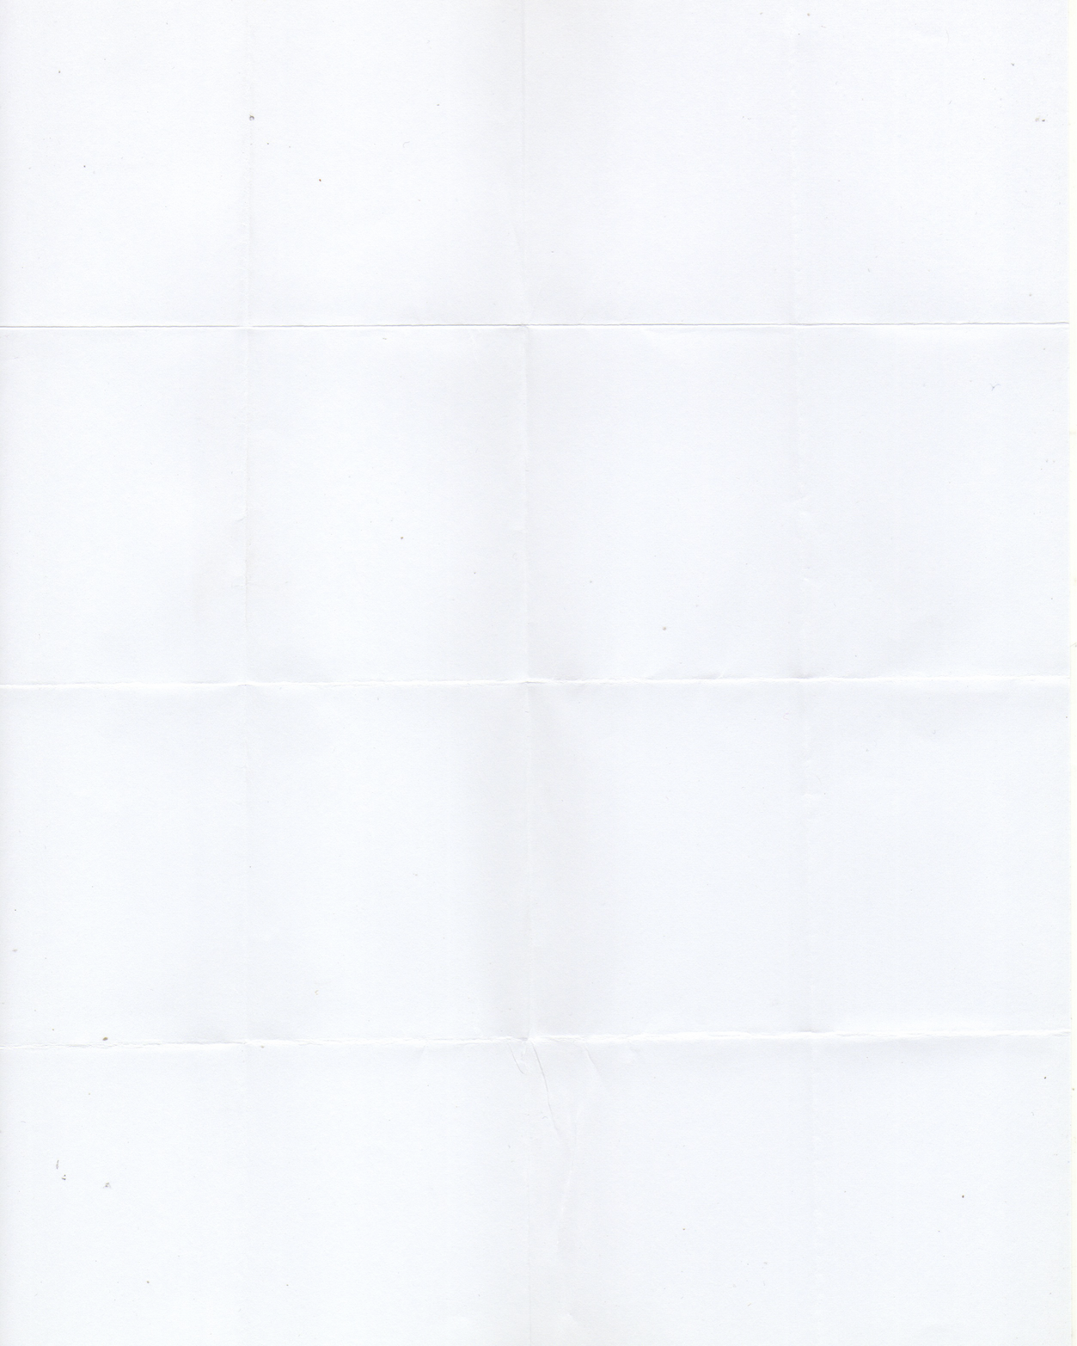


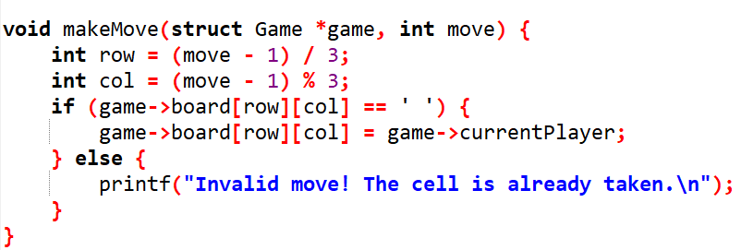
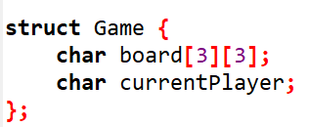
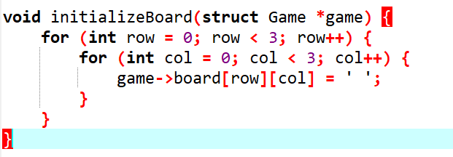
Concept used in development:
ARRAY:
Arrays are used to represent the Tic Tac Toe game board with a 3x3 2D array. Each element stores the status of a cell, which can be 'X', 'O', or ' ' (empty).

Slide 5
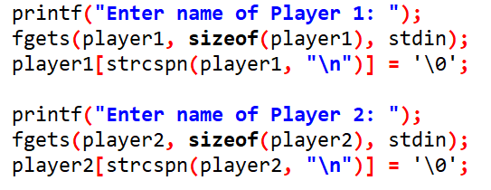
STRING:
Strings store player names, captured using fgets() to ensure safe input. strcspn() removes the newline character from the input.

Slide 6
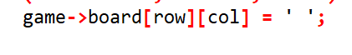
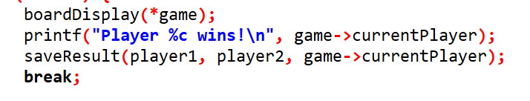
POINTER:
Pointers are used in various places in your Tic Tac Toe code to efficiently manage memory, modify data, and handle strings.

Slide 7
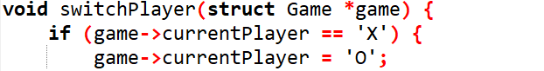
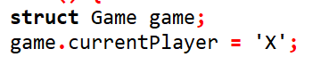
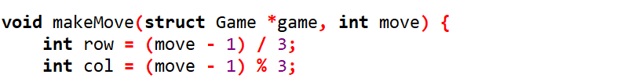
STRUCTURE:
A structure struct Game is used to represent the game state, containing:
3x3 Board (char board[3][3]): Stores the Tic-Tac-Toe board.
Current Player (char currentPlayer): Tracks the current player's turn.

Slide 8
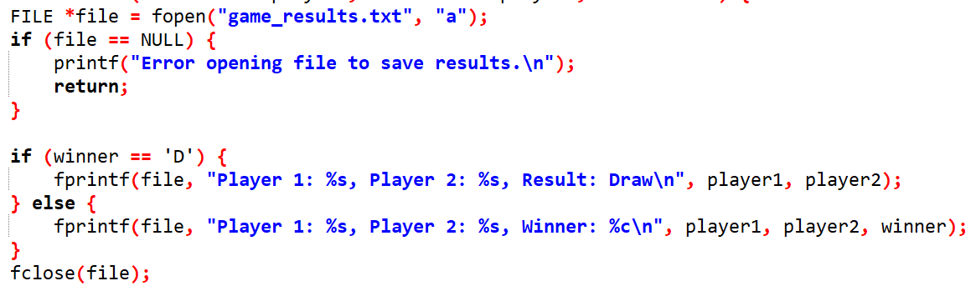
FILE HANDLING:
File handling is used to save game results in game_results.txt. After each game, the outcome (win or draw) and player names are appended to the file.

Slide 9
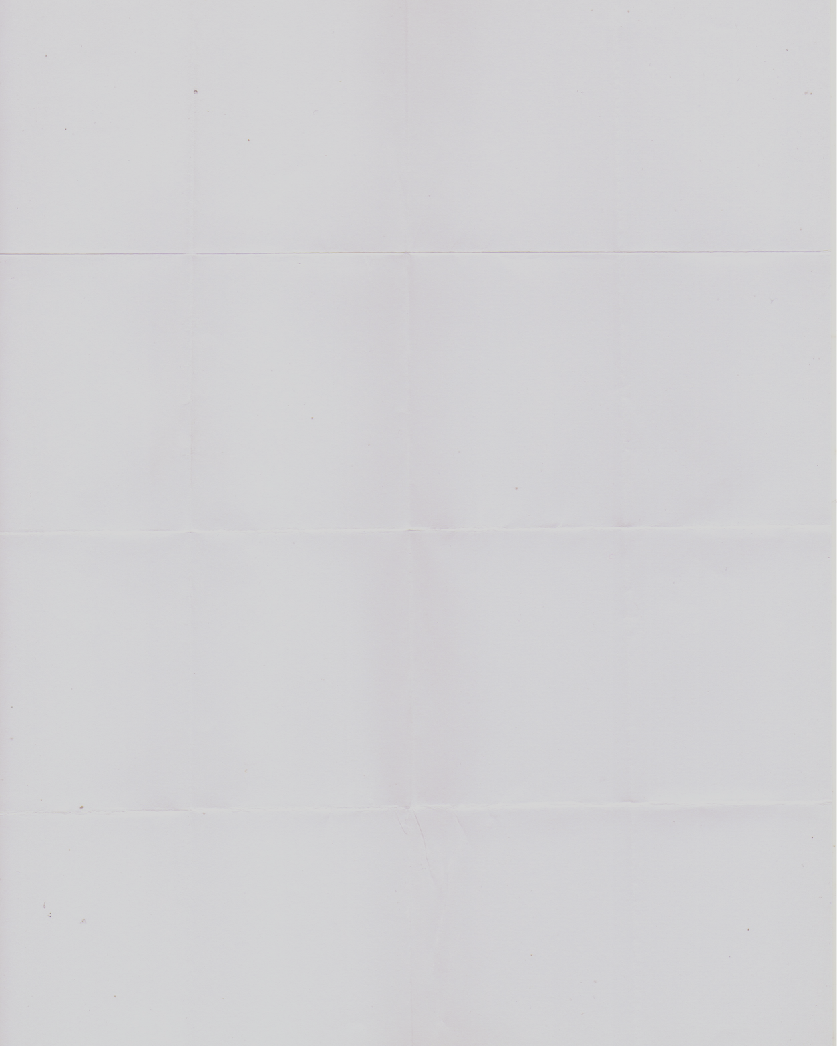
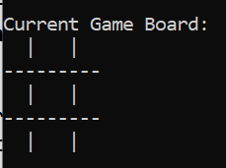
PROGRAM DESIGN:
boardDisplay()
initializeBoard()
This function does not display anything. It initializes the board to be empty (' ' in all cells) but does not output anything to the screen.

Slide 10
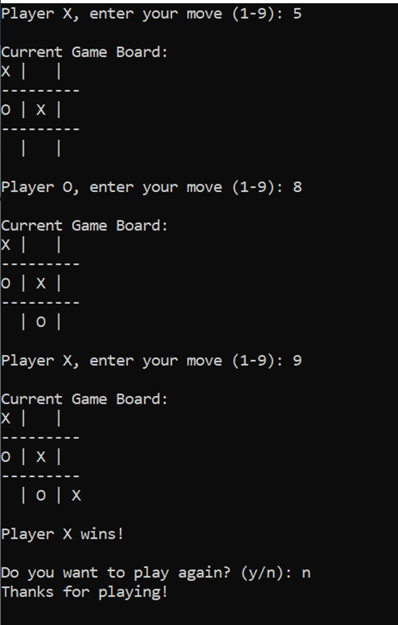
PROGRAM DESIGN:
makeMove()
checkingWinner()
This function does not directly display anything, but it may print a message if the move is invalid (i.e., when a player tries to occupy an already filled space).
This function does not display anything. It checks if there's a winner but does not print anything. It returns a boolean indicating whether a player has won.

Slide 11
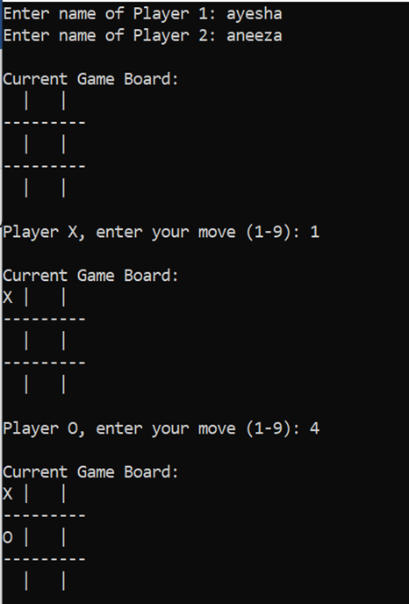
PROGRAM DESIGN:
boardFull()
gameplay()
This function controls the game flow, calling other functions. It may display messages such as:
It checks if the board is full (for a draw scenario) but does not print anything. It returns a boolean indicating whether the board is full.

Slide 12



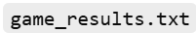
PROGRAM DESIGN:
switchPlayer()
saveResult()
It switches the current player from 'X' to 'O' or vice versa, but no message is printed during the switch.
It saves the result of the game (winner or draw) to a file but does not print anything to the screen.

Slide 13
Thanks!

